Slide 1


Introduction to Git and GitHub
Fondren Library
Digital Scholarship Services

Slide 2

WHAT IS GIT?
The most widely used version-control system!
Remembers entire project history
Easily undo changes
Track contributions
Free and Open-Source Software
Fast & Simple
Optimized for collaboration
Non-linear development
6/16/19
Digital Scholarship Services | Email cf24@rice.edu | library.rice.edu/dss
1

Slide 3
WHAT IS GIT NOT?
Affiliated with GitHub (which is owned by Microsoft)
A file editor
A graphical user interface
Many user interfaces exist
Proactive
Must tell git about everything we do!
6/16/19
Digital Scholarship Services | Email cf24@rice.edu | library.rice.edu/dss
1

Slide 4


WHAT IS GITHUB?
The largest host for Git repositories
Free (for public repositories)
A great place to collaborate
Support for unique features
Comment sections
Organizations
Issue tracking
Extensible!
6/16/19
Digital Scholarship Services | Email cf24@rice.edu | library.rice.edu/dss
1

Slide 5
WHAT IS GITHUB NOT?
The only option
GitLab, Bitbucket, …
A version-control system
Everything is on top of git
Only for source code and programming
Difficult!
6/16/19
Digital Scholarship Services | Email cf24@rice.edu | library.rice.edu/dss
1

Slide 6
GITHUB & GITHUB DESKTOP
A walkthrough of the user interfaces
6/16/19
Digital Scholarship Services | Email cf24@rice.edu | library.rice.edu/dss
1

Slide 7
GETTING OUR BEARINGS
6/16/19
Digital Scholarship Services | Email cf24@rice.edu | library.rice.edu/dss
1

Slide 8
STRUCTURE OF A GIT REPOSITORY
Snapshots, Locality, File States
6/16/19
Digital Scholarship Services | Email cf24@rice.edu | library.rice.edu/dss
1

Slide 9
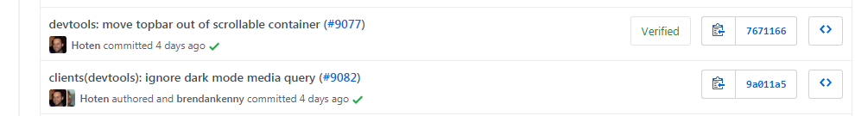
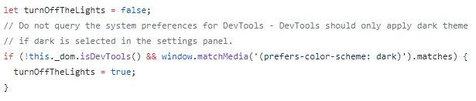

SNAPSHOTS
Sample Snapshot: Caption and Set of Files
Can see all files present at any of these times!
6/16/19
Digital Scholarship Services | Email cf24@rice.edu | library.rice.edu/dss
1

Slide 10
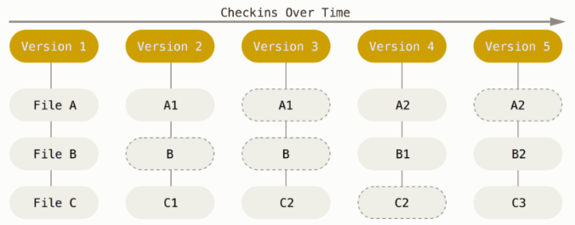
SNAPSHOTS
Stores the entire file structure at each snapshot, not a set of changes to one file!
6/16/19
Digital Scholarship Services | Email cf24@rice.edu | library.rice.edu/dss
1

Slide 11
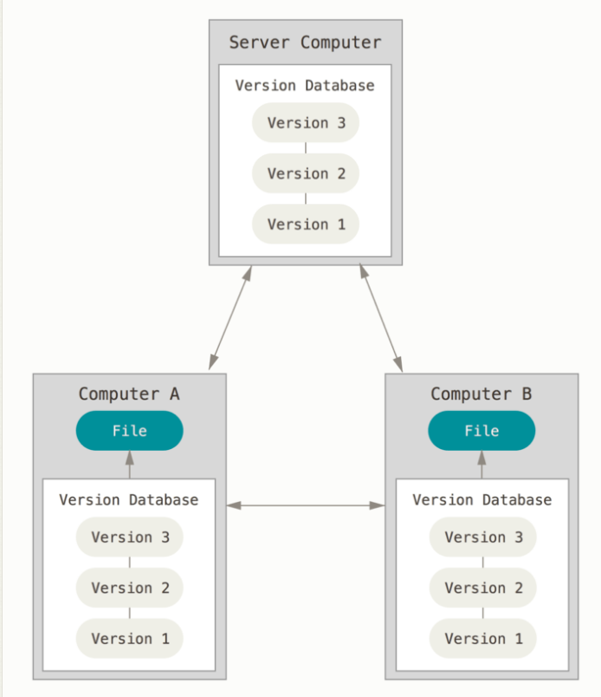
LOCALITY
Snapshots stored on your computer, not only on a server!
Hidden .git directory
Stores entire history of project (compressed!)
6/16/19
Digital Scholarship Services | Email cf24@rice.edu | library.rice.edu/dss
1

Slide 12
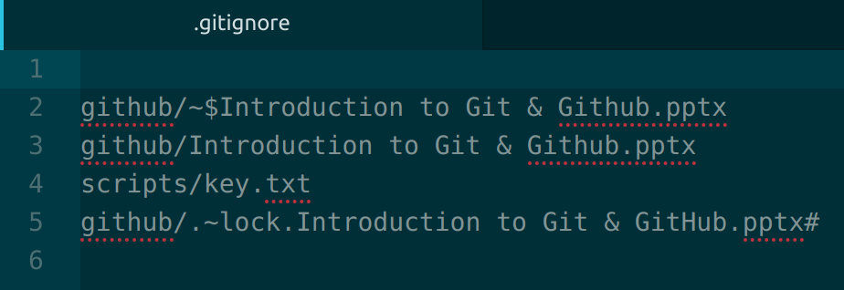
SPECIAL FILE: .GITIGNORE
.gitignore (note the period!)
A set of filenames. No file in here will be added
Common Uses: backup files, stored passwords for APIs
6/16/19
Digital Scholarship Services | Email cf24@rice.edu | library.rice.edu/dss
1

Slide 13
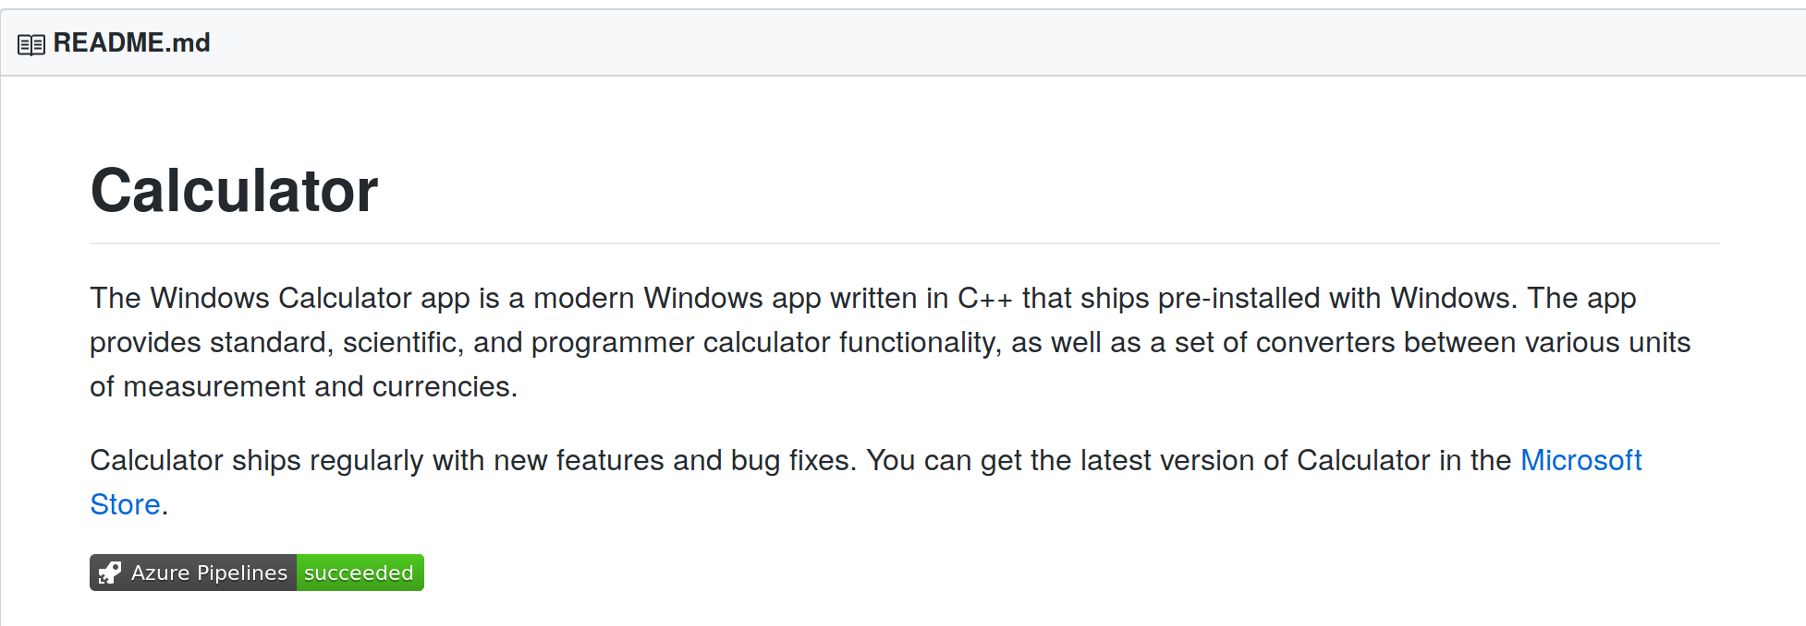
SPECIAL FILE: README.md
README.md (note the case!)
A text-based description of a directory or project
Uses Markdown language. Coming up next!
6/16/19
Digital Scholarship Services | Email cf24@rice.edu | library.rice.edu/dss
1

Slide 14
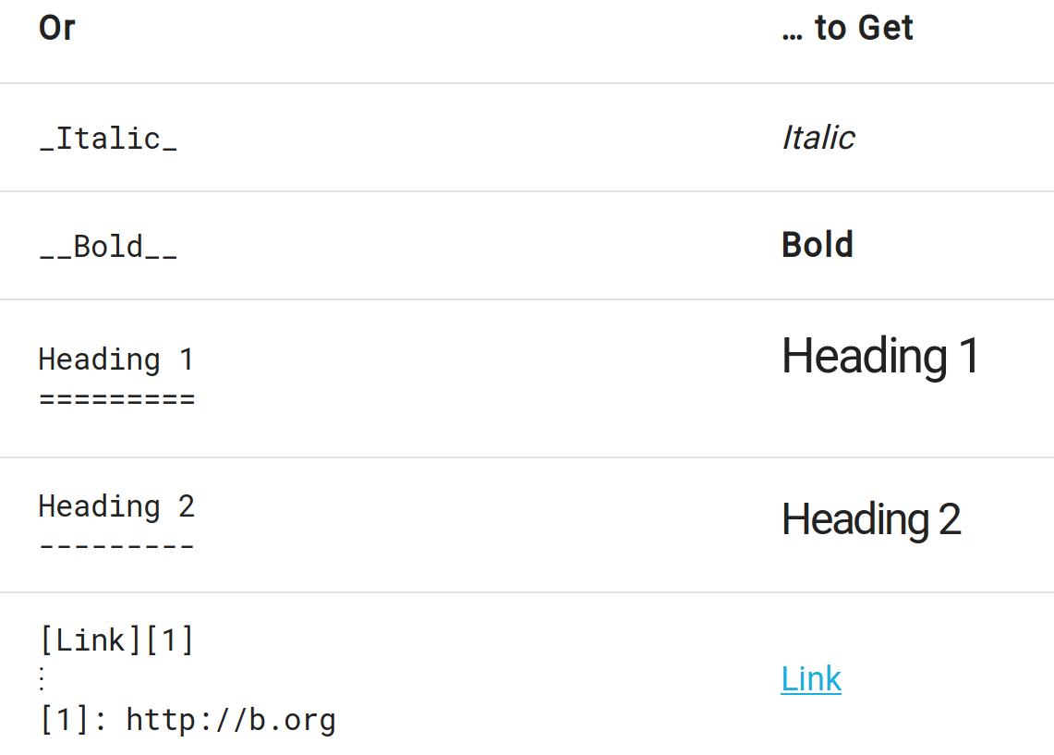
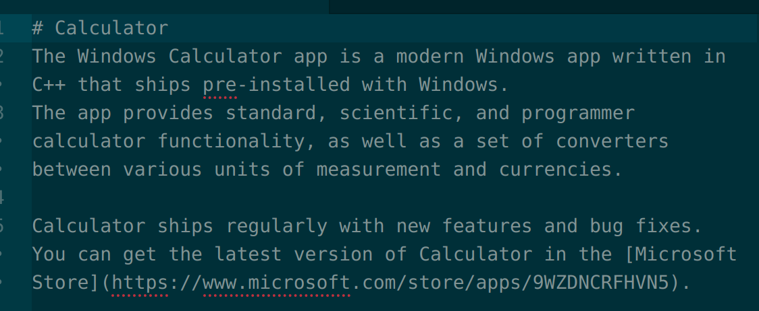
MARKDOWN
Simple formatting and text only
Many dialects
Used in a lot of places (Reddit)
6/16/19
Digital Scholarship Services | Email cf24@rice.edu | library.rice.edu/dss
1

Slide 15
STATES OF FILES IN A REPOSITORY
untracked: git has not been told about this file.
modified: we told git about this file, but we've changed it without telling git to remember our change.
staged: we have told git about this file and told git we will want it to remember our change.
committed: we have made git take a snapshot of our file.
6/16/19
Digital Scholarship Services | Email cf24@rice.edu | library.rice.edu/dss
1

Slide 16
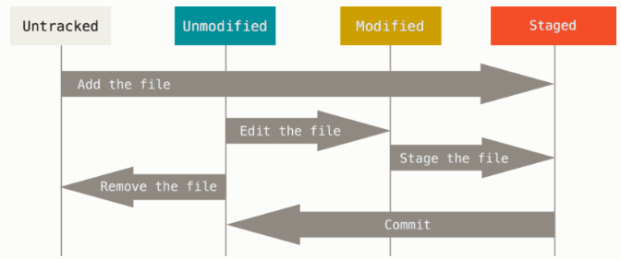
STATES OF FILES IN A REPOSITORY
6/16/19
Digital Scholarship Services | Email cf24@rice.edu | library.rice.edu/dss
1

Slide 17
CREATING & CLONING REPOSITORIES
Initialization & Copying from a server
6/16/19
Digital Scholarship Services | Email cf24@rice.edu | library.rice.edu/dss
1

Slide 18
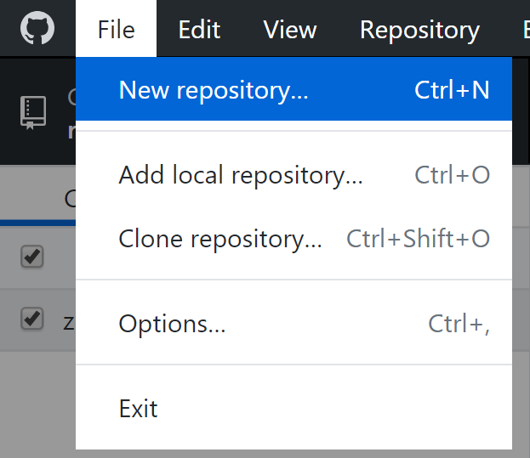
INITIALIZATION
Create a repository, with a file index and database
Stored in the hidden directory .git
Note: No files are added to the repository by default!
We’ll get to adding files a bit later
6/16/19
Digital Scholarship Services | Email cf24@rice.edu | library.rice.edu/dss
1

Slide 19
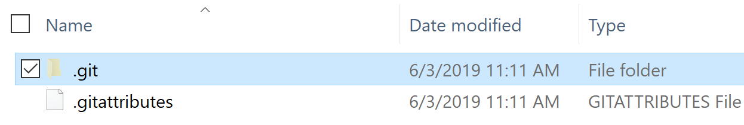
INITIALIZATION
Create a repository, with a file index and database
Stored in the hidden directory .git
Note: No files are added to the repository by default!
We’ll get to adding files a bit later
6/16/19
Digital Scholarship Services | Email cf24@rice.edu | library.rice.edu/dss
1

Slide 20
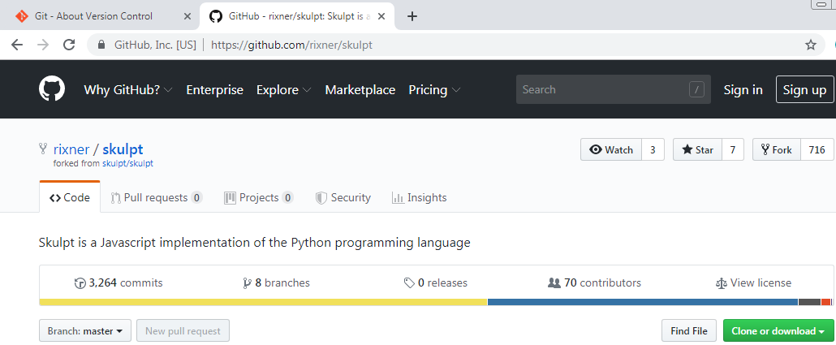
CLONING
Downloads entire history of a repository hosted on GitHub
Two ways to get the URL:
6/16/19
Digital Scholarship Services | Email cf24@rice.edu | library.rice.edu/dss
1

Slide 21
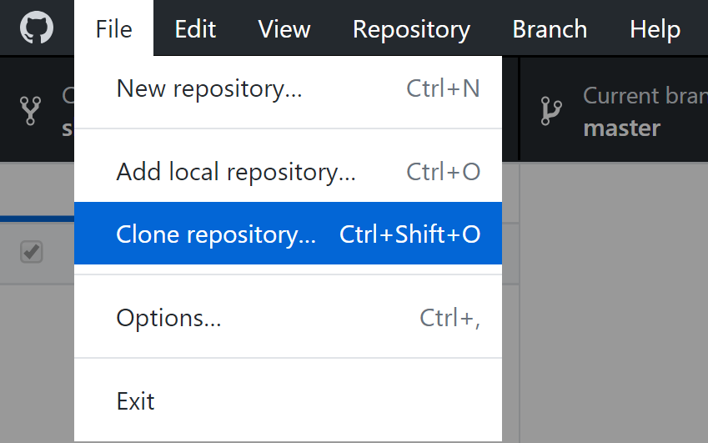
CLONING
Most recent snapshot immediately available
Full history needs to be downloaded as well. Takes time & space!
6/16/19
Digital Scholarship Services | Email cf24@rice.edu | library.rice.edu/dss
1

Slide 22
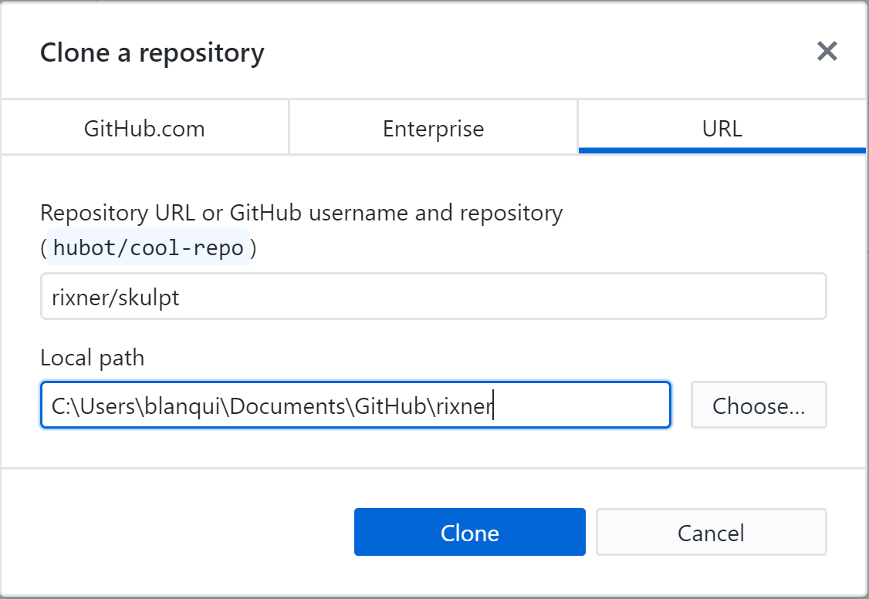
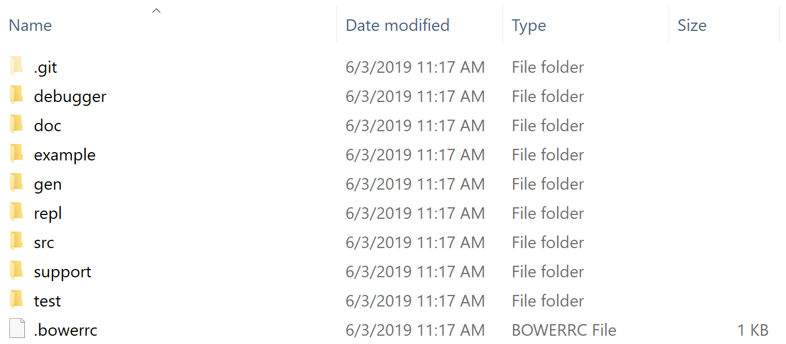
CLONING
6/16/19
Digital Scholarship Services | Email cf24@rice.edu | library.rice.edu/dss
1

Slide 23
CLONING
Clone this repository from GitHub now!
https://github.com/bakitybacon/rice-data-and-donuts-github
6/16/19
Digital Scholarship Services | Email cf24@rice.edu | library.rice.edu/dss
1

Slide 24
EDITING WORKFLOW
Editing, adding, staging, and committing
6/16/19
Digital Scholarship Services | Email cf24@rice.edu | library.rice.edu/dss
1

Slide 25
REVIEW OF FILE STATES
6/16/19
Digital Scholarship Services | Email cf24@rice.edu | library.rice.edu/dss
1

Slide 26
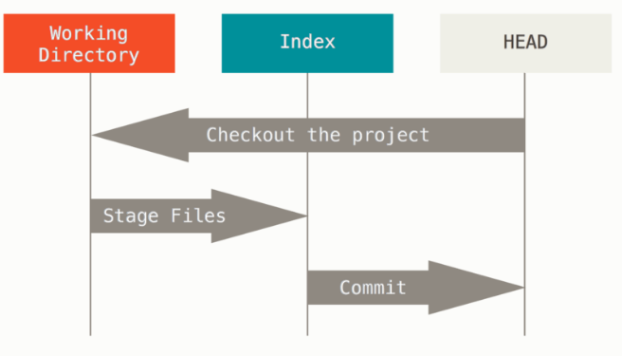
WORKFLOW
Working Directory
Changed files on disk.
Index
We’ve told git to pay attention to these changes.
HEAD
This is just the most recent commit (snapshot). You can come back here whenever!
6/16/19
Digital Scholarship Services | Email cf24@rice.edu | library.rice.edu/dss
1

Slide 27
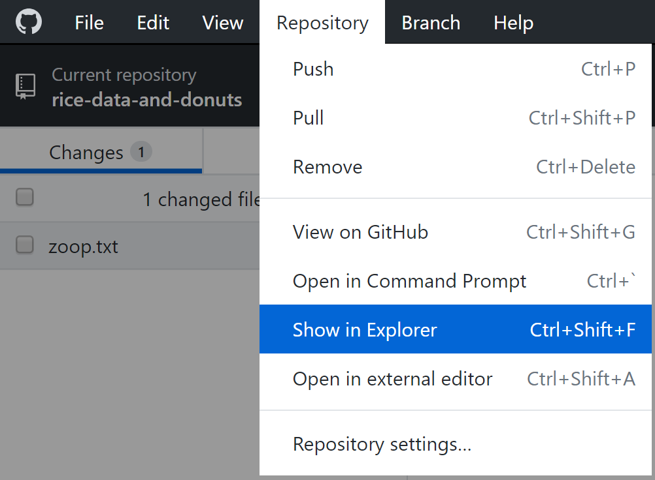
EDITING A FILE LOCALLY
Open and edit any file using any program
Use “Show in Explorer” to easily find the most recent files
6/16/19
Digital Scholarship Services | Email cf24@rice.edu | library.rice.edu/dss
1

Slide 28
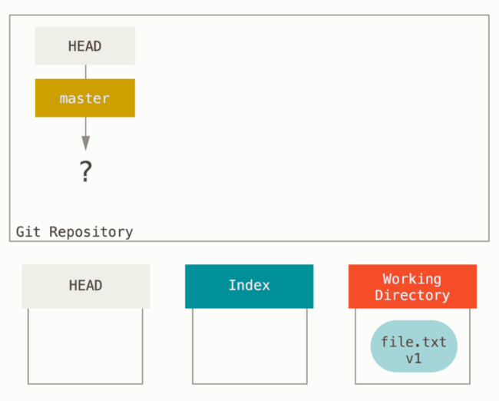
EDITING A FILE LOCALLY
Starting from an empty repository
How do we know?
HEAD doesn’t point to anything (no snapshots!)
We have edited a file in the Working Directory, but not yet told git to pay attention to it.
6/16/19
Digital Scholarship Services | Email cf24@rice.edu | library.rice.edu/dss
1

Slide 29
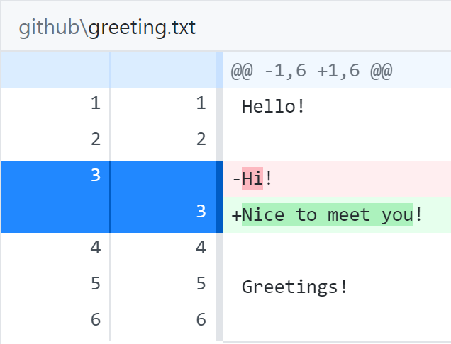
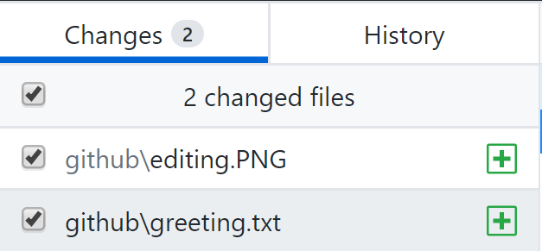
TELLING GIT ABOUT OUR CHANGES
Git will automatically find what we changed. All we have to do is tell it what we want to save
Toggle whether we want to add this change using check boxes
Monitor changes to text files
Green: added in
Red: taken out
White: not changed
6/16/19
Digital Scholarship Services | Email cf24@rice.edu | library.rice.edu/dss
1

Slide 30
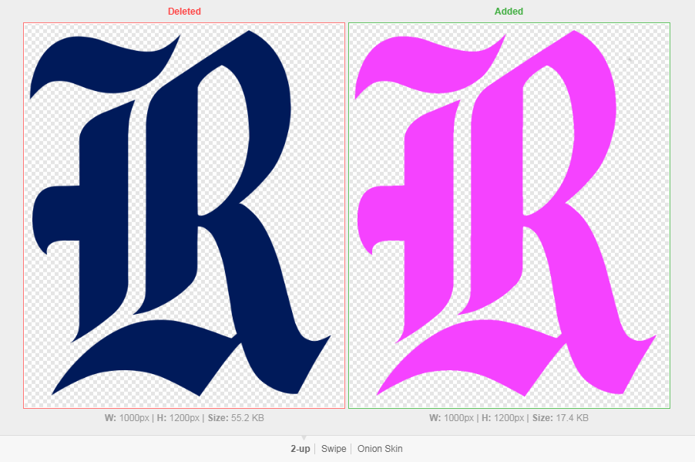
VIEWING CHANGES: IMAGES
2-Up: side-by-side
Swipe: left of divider is first image, right is second image
Onion Peel: images are overlaid, slider changes transparency setting
6/16/19
Digital Scholarship Services | Email cf24@rice.edu | library.rice.edu/dss
1

Slide 31
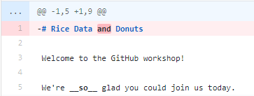
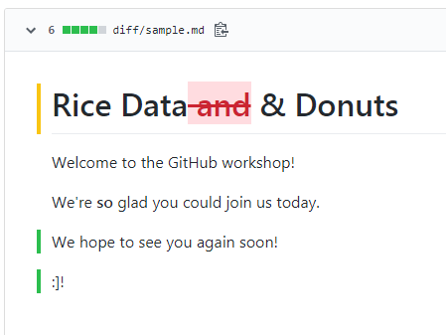
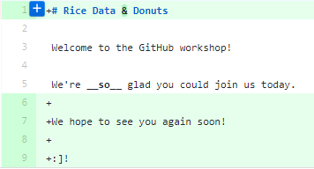
VIEWING CHANGES: DOCUMENTS
Prose Diff: see word-by-word changes in formatting
6/16/19
Digital Scholarship Services | Email cf24@rice.edu | library.rice.edu/dss
1

Slide 32
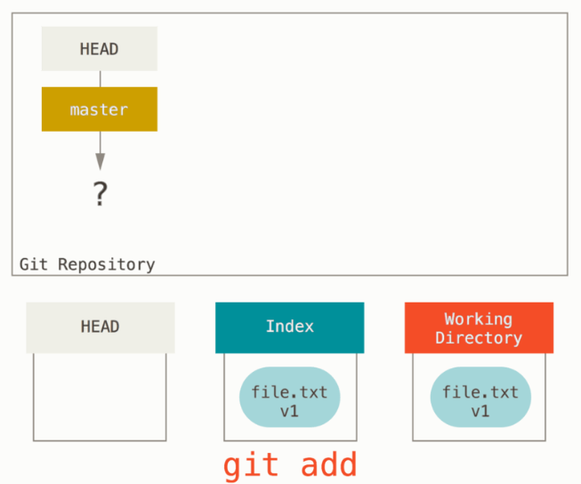
TELLING GIT ABOUT OUR CHANGES
Now that we have made file.txt, we can tell git to pay attention to the file
Transition between which two states for file.txt?
Command: git add
Whatever we have added will be changed in the new snapshot. No add means it won’t change!
6/16/19
Digital Scholarship Services | Email cf24@rice.edu | library.rice.edu/dss
1

Slide 33
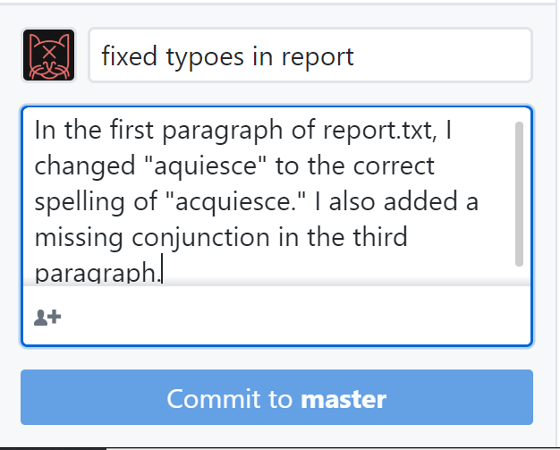
SNAPSHOTS OF OUR CHANGES
Once we have reached a milestone, or we just want to quickly and reversibly save our changes
Annotating our Snapshot
Short, simple summary. A few words
Extended description of approach. A few sentences
Only changes locally!
6/16/19
Digital Scholarship Services | Email cf24@rice.edu | library.rice.edu/dss
1

Slide 34
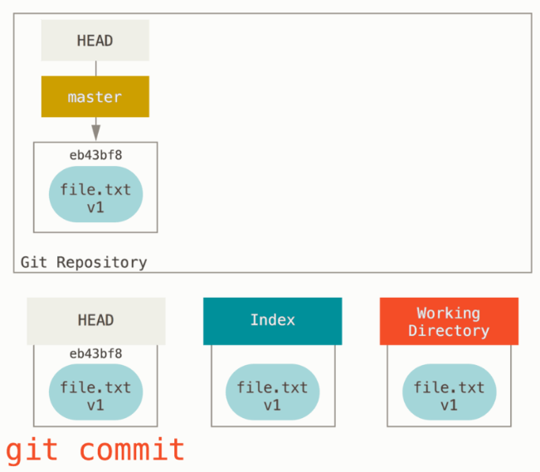
SNAPSHOTS OF OUR CHANGES
Tell git to take a snapshot of our files!
Transition between which two states for file.txt?
Command: git commit
HEAD now points to our most recent snapshot!
6/16/19
Digital Scholarship Services | Email cf24@rice.edu | library.rice.edu/dss
1

Slide 35
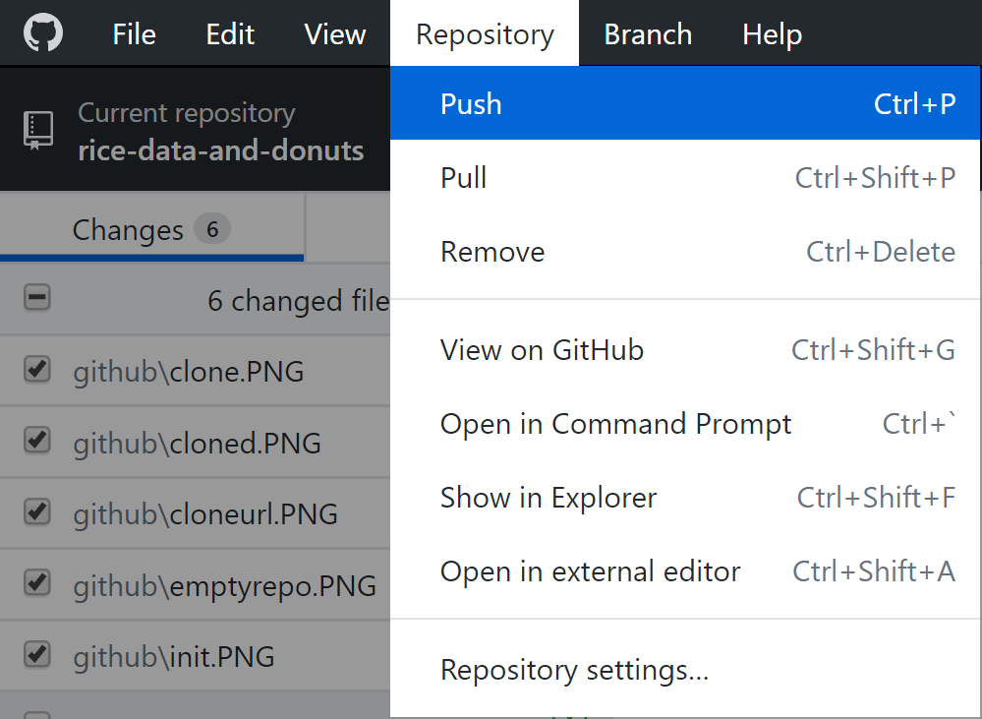
UPLOADING OUR CHANGES
Once we have a commit, we can send it to GitHub
This is called a push
Note: Changes are not sent to the server by default!
6/16/19
Digital Scholarship Services | Email cf24@rice.edu | library.rice.edu/dss
1

Slide 36
UPLOADING OUR CHANGES
From the repository cloned earlier, upload a file with any message you like!
6/16/19
Digital Scholarship Services | Email cf24@rice.edu | library.rice.edu/dss
1

Slide 37
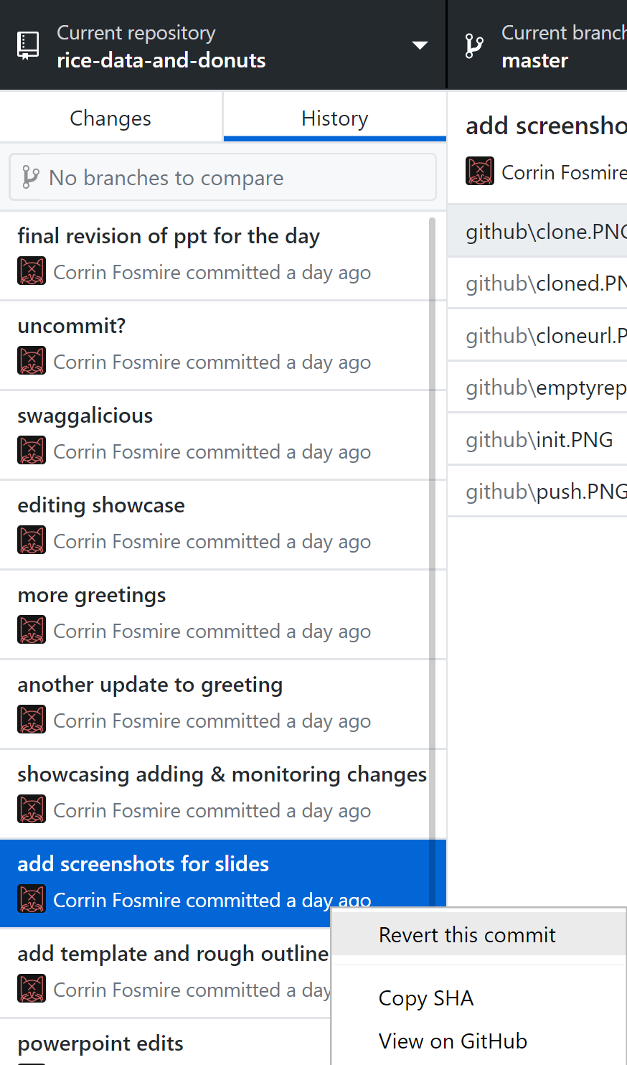
GOING BACK IN TIME
What if we accidentally made a change that deleted something we really needed?
Solution: Revert to a previous commit!
Note this doesn’t delete the changes after the revert
6/16/19
Digital Scholarship Services | Email cf24@rice.edu | library.rice.edu/dss
1

Slide 38
GOING BACK IN TIME
Revert your message, then commit something different and push again!
6/16/19
Digital Scholarship Services | Email cf24@rice.edu | library.rice.edu/dss
1

Slide 39
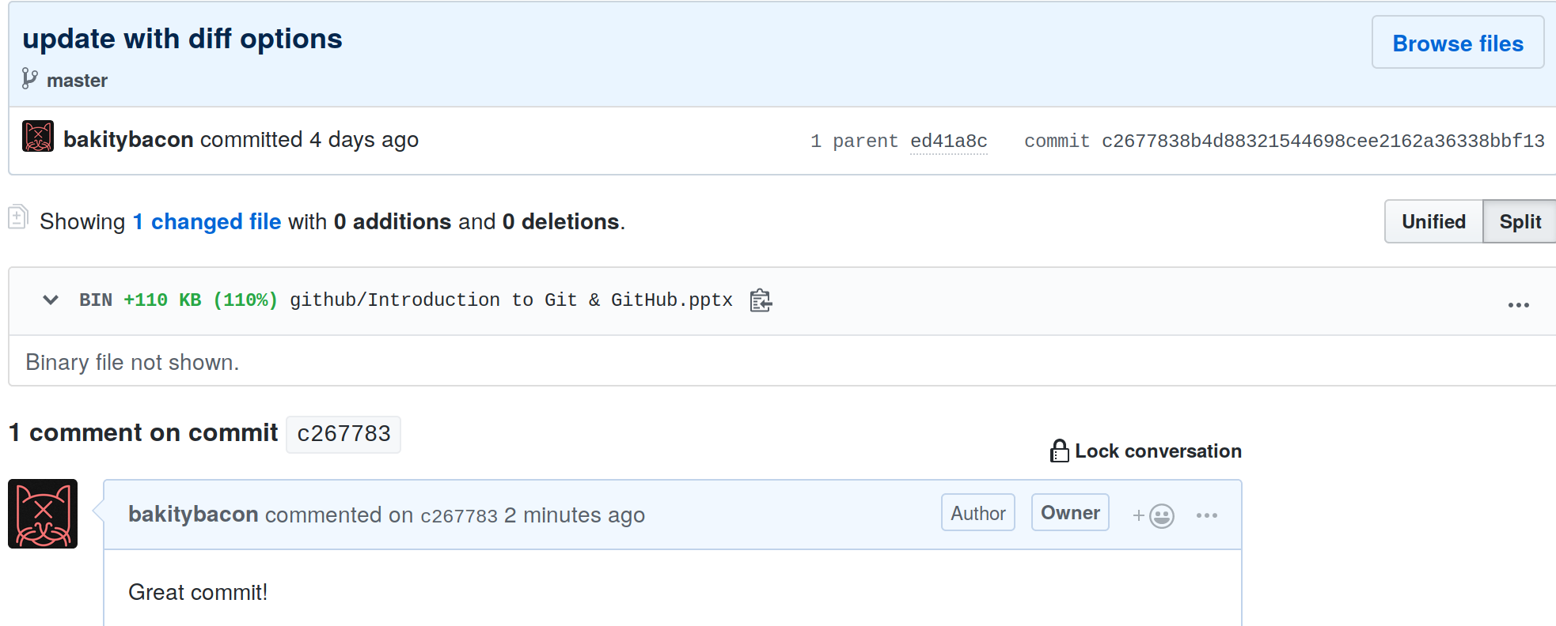
MAKING COMMENTS
GitHub allows us to write comments about a commit
Aids discussion of changes, hopefully productive arguments
History → Commits → Right Click → View on GitHub
6/16/19
Digital Scholarship Services | Email cf24@rice.edu | library.rice.edu/dss
1

Slide 40
MAKING COMMENTS
Make a comment on either the revision or the original commit you made!
6/16/19
Digital Scholarship Services | Email cf24@rice.edu | library.rice.edu/dss
1

Slide 41
BRANCHES & MERGING
Creating, working on, combining, and switching branches
6/16/19
Digital Scholarship Services | Email cf24@rice.edu | library.rice.edu/dss
1

Slide 42
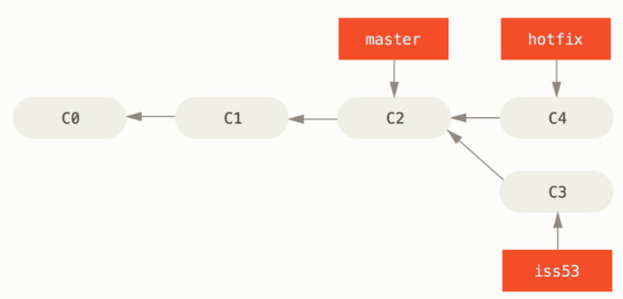
BRANCHES
If you’re working on different features or as part of a larger team
Divergent history
Independent files
Avoids unintended consequences!
Easy integration
6/16/19
Digital Scholarship Services | Email cf24@rice.edu | library.rice.edu/dss
1

Slide 43
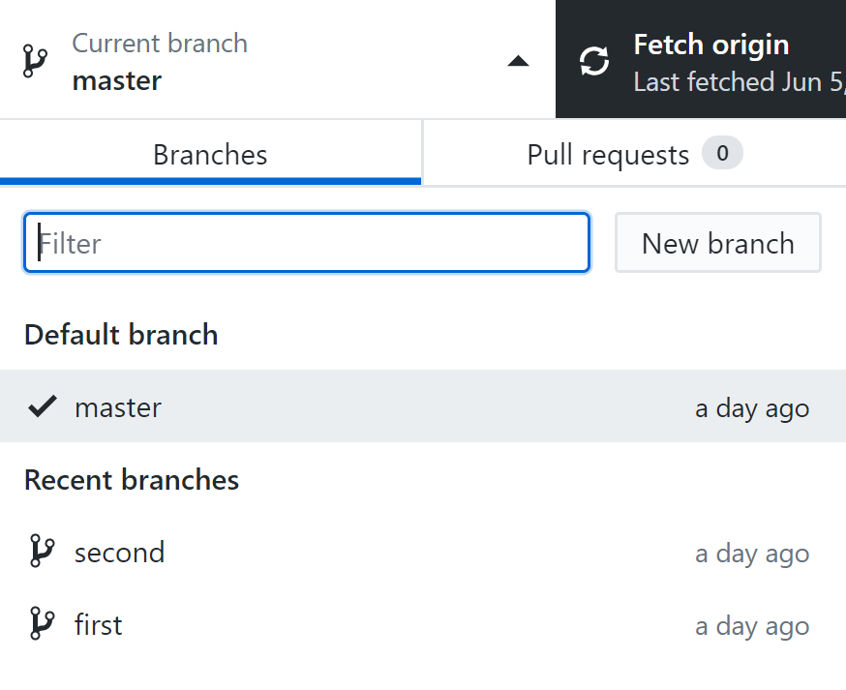
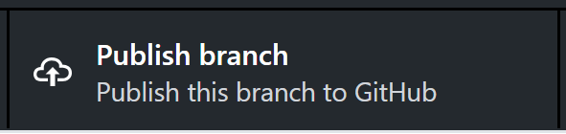
CREATING & SWITCHING BRANCHES
Click on the “Current branch” tab
If a branch isn’t listed, you may have to search for it
Make sure to publish the branch to GitHub!
6/16/19
Digital Scholarship Services | Email cf24@rice.edu | library.rice.edu/dss
1

Slide 44
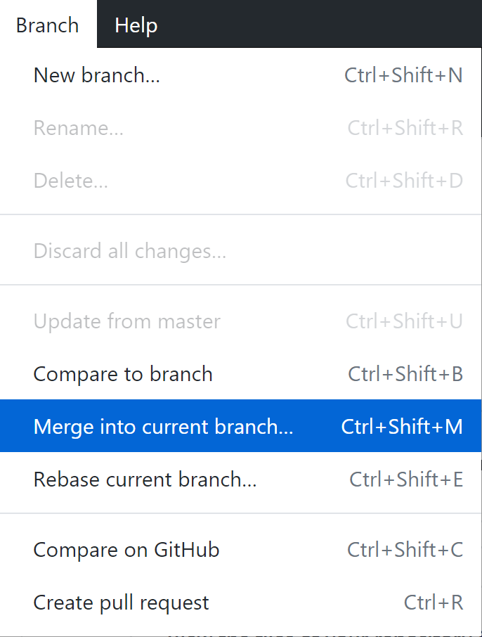
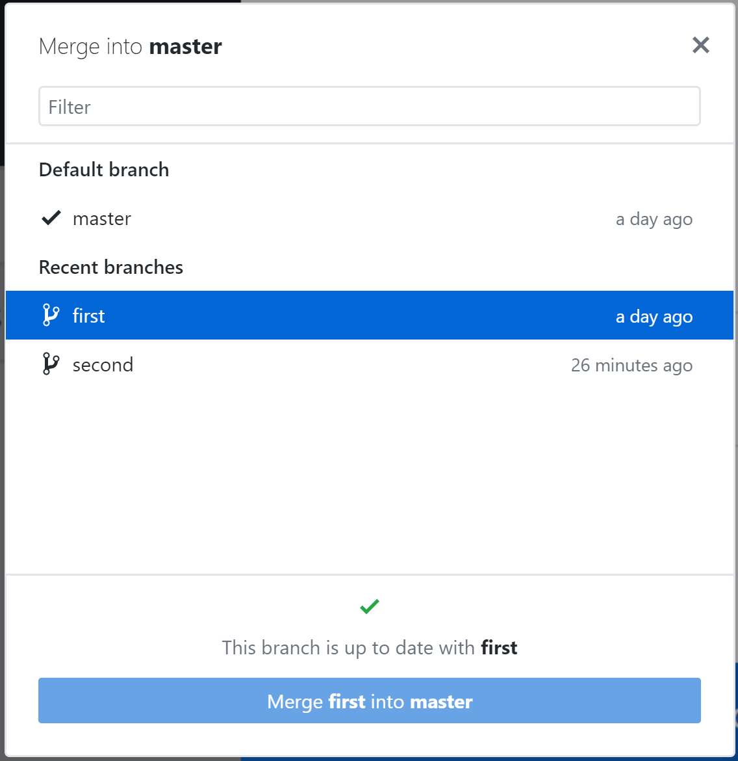
MERGING
Integrates changes that take place in a different branch
Usually goes smoothly if branches don’t overlap
6/16/19
Digital Scholarship Services | Email cf24@rice.edu | library.rice.edu/dss
1

Slide 45
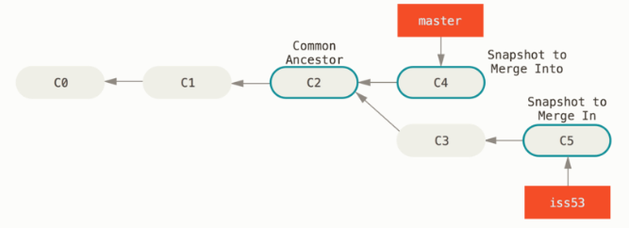
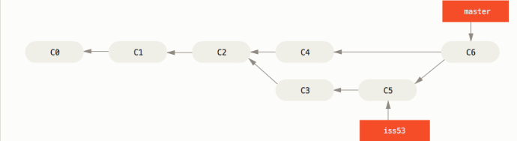
MERGING
6/16/19
Digital Scholarship Services | Email cf24@rice.edu | library.rice.edu/dss
1

Slide 46
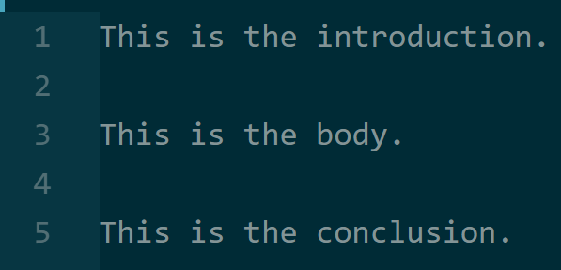
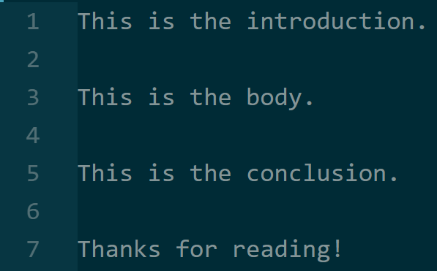
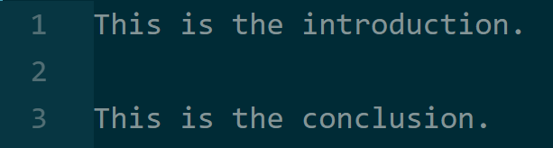
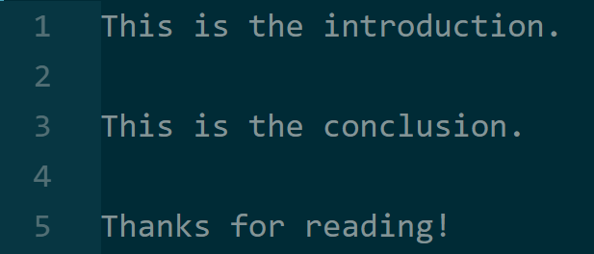
MERGING IN ACTION
Branch 1
(INTO)
Branch 1
(MERGED)
Branch 2
(IN)
6/16/19
Digital Scholarship Services | Email cf24@rice.edu | library.rice.edu/dss
1

Slide 47
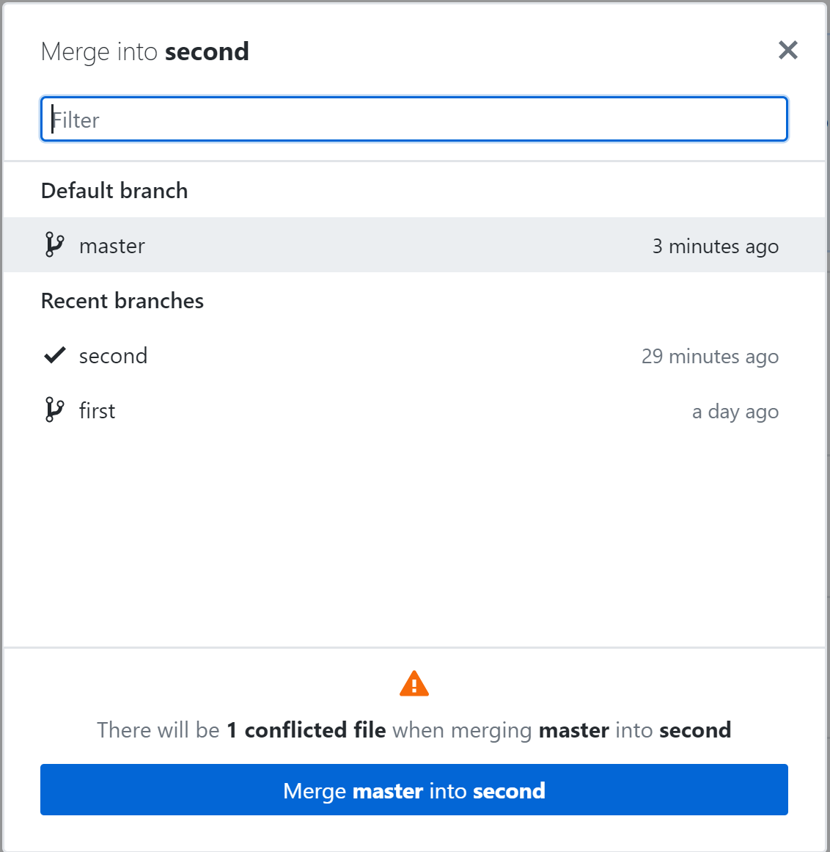
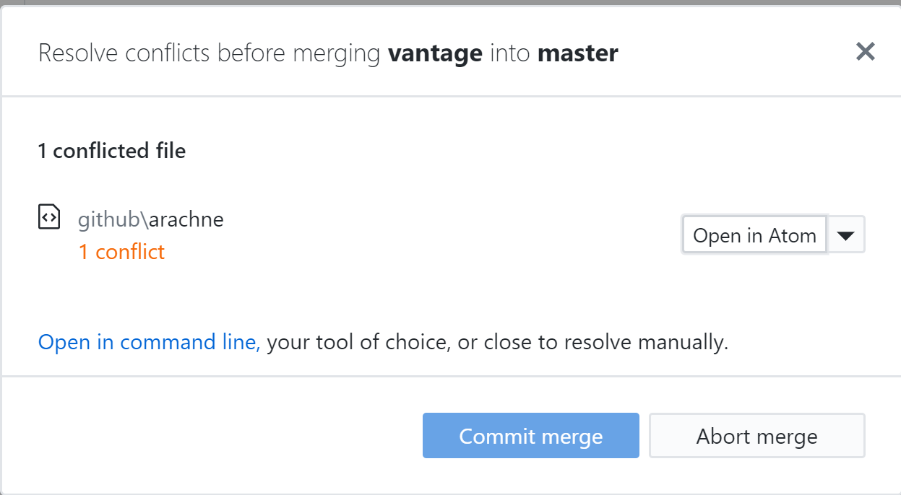
CONFLICTS
Occasionally, two people may have edited the same part of the same file on different branches
Which version do we take?
Must manually resolve conflicts
6/16/19
Digital Scholarship Services | Email cf24@rice.edu | library.rice.edu/dss
1

Slide 48
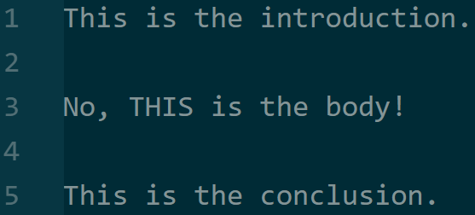
CONFLICTS IN ACTION
?
6/16/19
Digital Scholarship Services | Email cf24@rice.edu | library.rice.edu/dss
1

Slide 49
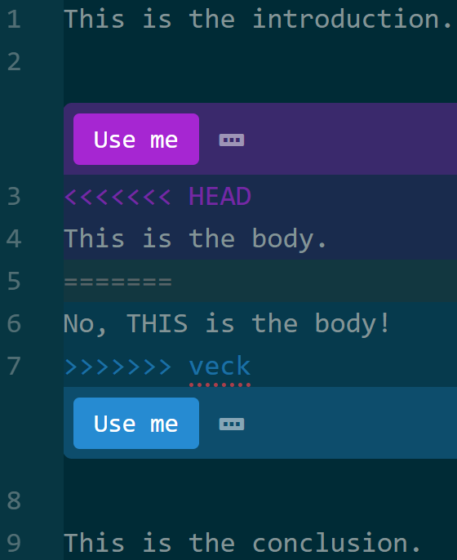
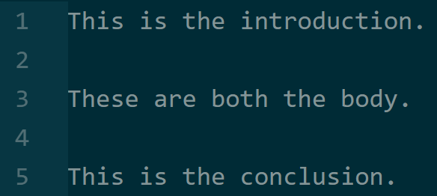
CONFLICTS IN ACTION
6/16/19
Digital Scholarship Services | Email cf24@rice.edu | library.rice.edu/dss
1

Slide 50
CONFLICTS AND MERGING
Create a new branch.
Edit community.txt to include only a one-line message.
Try to merge it.
If it fails, merge by combining the two messages. Don’t delete anyone else’s work!
6/16/19
Digital Scholarship Services | Email cf24@rice.edu | library.rice.edu/dss
1

Slide 51
DISTRIBUTED WORK
Paradigms for getting the most out of working as a team
6/16/19
Digital Scholarship Services | Email cf24@rice.edu | library.rice.edu/dss
1

Slide 52
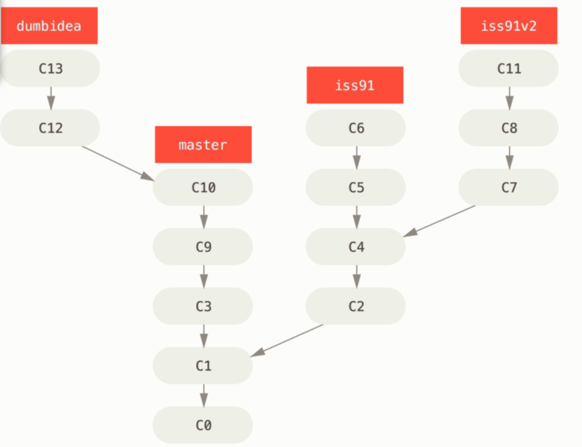
BRANCHING WORKFLOWS
Not technically distributed
Try a lot of things out on separate branches & merge!
Can work on many problems at the same time
6/16/19
Digital Scholarship Services | Email cf24@rice.edu | library.rice.edu/dss
1

Slide 53
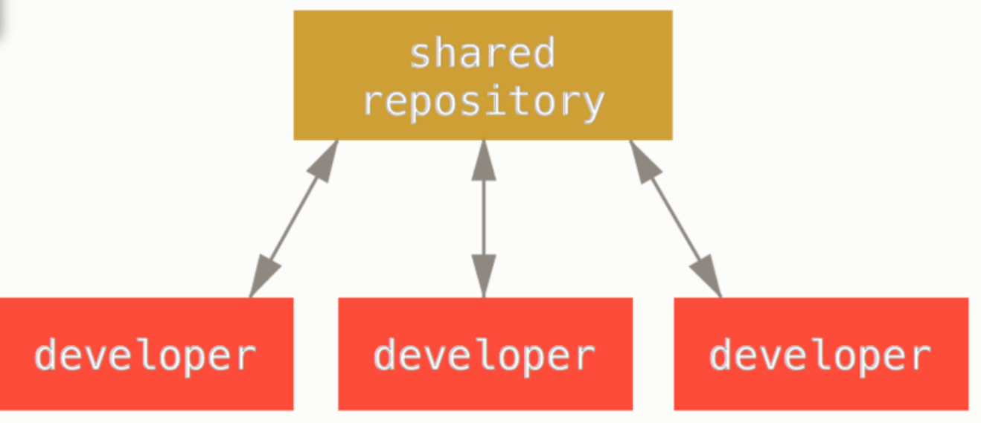
CENTRALIZED WORKFLOW
Everyone is equal
Leverages branches
Everyone must merge their own work!
What if you don’t like how someone else merged?
No overhead from dedicated integration manager
6/16/19
Digital Scholarship Services | Email cf24@rice.edu | library.rice.edu/dss
1

Slide 54
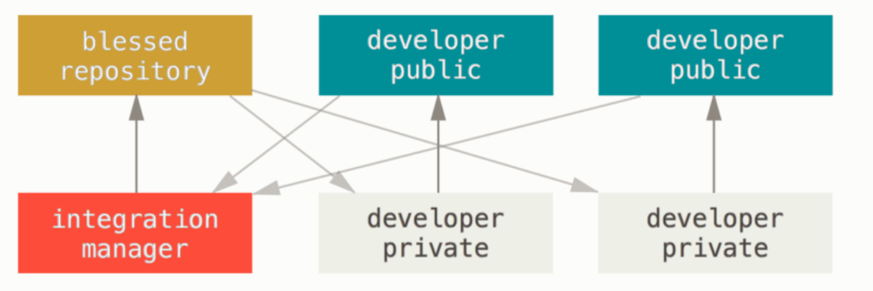
INTEGRATION MANAGER WORKFLOW
Developers have copies of the “blessed” repository
They make changes, then ask integration manager to incorporate them
More overhead
More accountability
6/16/19
Digital Scholarship Services | Email cf24@rice.edu | library.rice.edu/dss
1

Slide 55
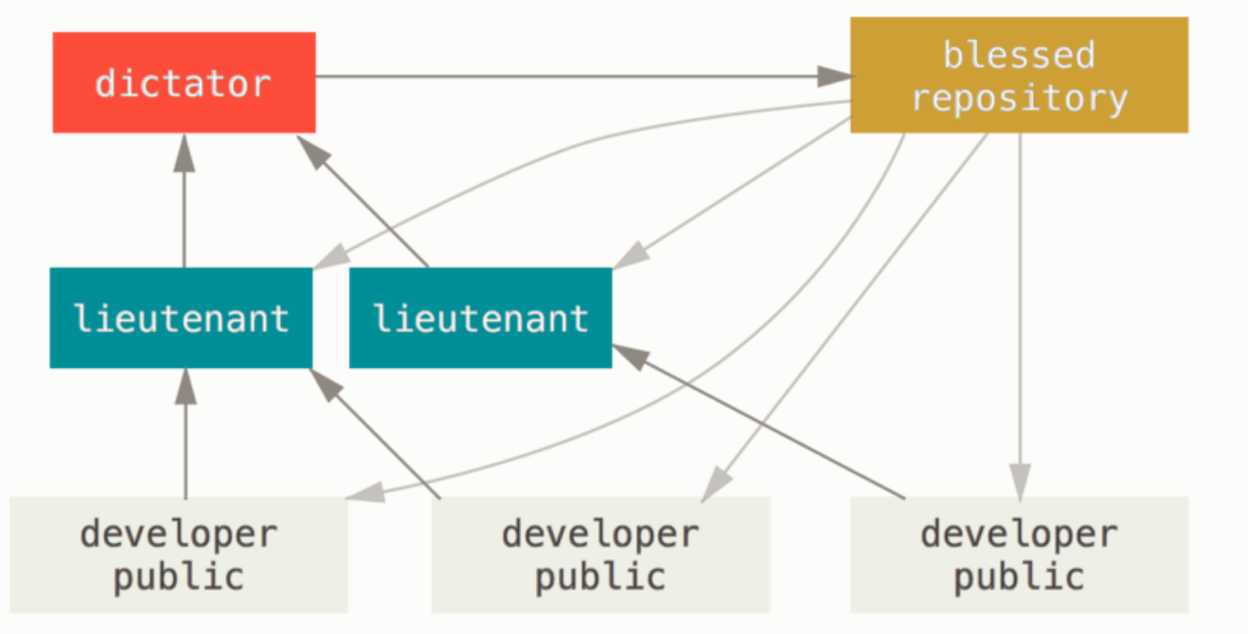
LIEUTENANT & DICTATOR WORKFLOW
Essentially the same as integration manager with one more layer to go through
More overhead, but can use expertise effectively
Lieutenant 1 expert in programming, Lieutenant 2 in design, for example
6/16/19
Digital Scholarship Services | Email cf24@rice.edu | library.rice.edu/dss
1

Slide 56
ACKNOWLEDGMENTS
The figures are taken from Pro Git book, written by Scott Chacon and Ben Straub and published by Apress, used under the terms of the Creative Commons Attribution-NonCommercial-ShareAlike 3.0 Unported License.
The GitHub Mark and Octocat are used under their official license (https://github.com/logos)
The Git logo is used under the Creative Commons Attribution 3.0 Unported License.
Screenshots are taken from GitHub Desktop and Atom.
6/16/19
Digital Scholarship Services | Email cf24@rice.edu | library.rice.edu/dss
1

Slide 57
INTEGRATION MANAGER WORKFLOW IN GITHUB
You can see this workflow in GitHub all the time
Fork & Pull Request:
Make a copy of a repository
Make a change
Ask the original repository’s owner to “pull” your proposed change into his project
6/16/19
Digital Scholarship Services | Email cf24@rice.edu | library.rice.edu/dss
<number>

